Slide 1
Applications of Context for Artificial Intelligence
Quentin Truong

Slide 2
Overview
Basic Problem
Visual Cues
Context Filtering
AlphaGo as example
Object relationships in Language
BYU Solution
Future Applications
Citations
Questions

Slide 3
Basic Knowledge Problem
Ask a robot to bring you a cup
It doesn't know how to find, pick up, transport etc.
Might break the cup or break itself
Must be told how to do all of this
We consider this knowledge trivial
Understand how to hold cups, where cups are located, etc.
Humans use this contextual knowledge of objects
But robots don't know
Must obtain this knowledge somehow

Slide 4
Visual Cues
When trying to pick up a cup, know what a cup is
because know the relative weight of a cup, know how to lift it
Robots often lack many of these cues
even if they can identify objects, often does not have extensive knowledge of these many objects
Idea of context cues extends beyond physical interactions
Humans have lots of general knowledge
Implicitly use this knowledge to solve problems

Slide 5
Basic Knowledge Problem
DARPA Robot Challenge
Robots can't open doors or walk really
https://youtu.be/g0TaYhjpOfo?t=26s
What we consider to be basic is actually fairly difficult
It's not simple to open a door or walk
Extends beyond robotics
AI will require a similarly extensive amount of knowledge

Slide 6
Context Filtering Problem
Humans can filter information
Humans often have some idea of what is likely to work and what is unlikely to work
Understand what information is relevant and what variables should be changed
Can use this to filter out poor solutions
Because search-space is smaller, humans can experimentally figure out new solutions to new problems
Machines don't have the knowledge to be capable of filtering
Machines don't know what is relevant and what is not
Must resort to brute-force search oftentimes
Search-space is likely to be intractably large
Will never find the solution if it cannot reduce the search-space

Slide 7
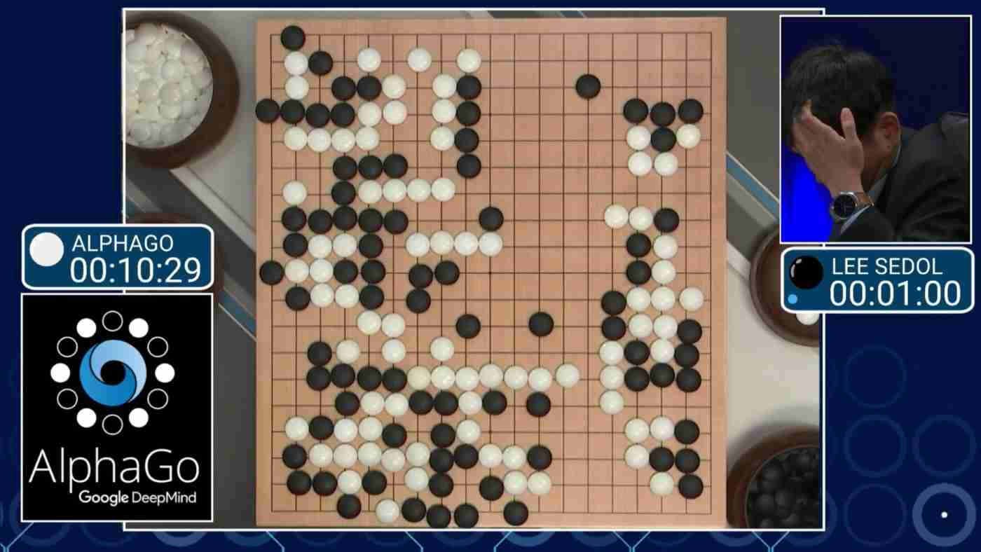
Search Space
AlphaGo
10^761
Search space intractable
Must reduce search space
Humans use intuition to reduce search space

Slide 8
Object Relationships Problem
Humans understand relationships between objects
We know how nouns relate to other verbs
But the machine does not know these sorts of things
Machines don't understand relationships between objects
You can dethrone a king, but you can't really 'harvest' a king (Christensen)
Machine doesn't know that you should not eat a table
Machines in unstructured environments perform terribly
Infeasible to hand-code this knowledge

Slide 9
Object Relationship Solution
Researchers at BYU download Wikipedia
Teach machine relationships between nouns and verbs
Use Wikipedia as a source of up-to-date text
Extract noun-verb relationships to find Affordances (set of actions that can be done with an object)
Apply math and figure out relationships between words in the text downloaded from Wikipedia
So now machine knows how nouns relate to other verbs

Slide 10
Results of the solution
BYU Researchers improve performance
For an unstructured text game where machines have to respond to textual input, improved performance on 12/16 games
This improvement was from understanding relationships between objects alone
Other improvements could include grammar, speaking conventions, etc

Slide 11
Future Applications
Basic Knowledge
Need machines to be capable of a variety of tasks if integrated in consumer environment
Must understand how to not break things
Must not break itself
Context Filtering
AI figure out solutions for unseen problems
Performance in unstructured environments
Language, Object Relationships
Easy, convenient format to communicate to machines
NLP

Slide 12
Citations
Brezillon, Patrick. “Context in Artificial Intelligence: I. A Survey of the Literature.” Advances in Applied Artificial Intelligence Lecture Notes in Computer Science, 2006, www.researchgate.net/profile/Patrick_Brezillon/publication/220106390_Context_in_Artificial_Intelligence_I_A_Survey_of_the_Literature/links/0fcfd50cb6dbdeb89f000000.pdf.
Christensen, Andrea. “Researchers Use Wikipedia to Give AI Context Clues.” Brigham Young University, 26 Sept. 2017, news.byu.edu/news/researchers-use-wikipedia-give-ai-context-clues.
Frantz, Roger. “Herbert Simon. Artificial Intelligence as a Framework for Understanding Intuition.” Journal of Economic Psychology, North-Holland, 19 Feb. 2003, www.sciencedirect.com/science/article/pii/S0167487002002076.
Sloman, Aaron. “Interactions between Philosophy and Artificial Intelligence: The Role of Intuition and Non-Logical Reasoning in Intelligence.” Artificial Intelligence, Elsevier, 21 Feb. 2003, www.sciencedirect.com/science/article/pii/0004370271900117.

Slide 13
Questions?

